Slide 1


United Airlines
Maintenance Optimization
Haoyang Xu, Yanqian Pan, Yuying Wang

Slide 2




Northwestern Team
Yuying
Wang
Yanqian Pan
Haoyang Xu

Slide 3

AGENDA
01
02
03
04
Background
EDA
Problem Statement & Project Description
Method &
Data Analysis
Model
Conclusion
AutoEncoder
Recommendation

Slide 4

01
Project Background

Slide 5

Background
Aviation Data Crucial for Safety:
United Airlines, one of the largest airlines globally, relies on accurate and reliable data to ensure safe and efficient operations.
Massive Data Generation:
Flight information
Engine performance
Fuel consumption
Challenges:
High complexity and data volume
Inefficiencies and safety risks

Slide 6
Why It's Important?
Safety
Efficiency
Regulatory Compliance
Mechanical issues
Potential accidents
Reduced fuel consumption
Better route planning
Ensure compliance with regulations
Avoid fines and legal issues

Slide 7

Purpose
Enhance the reliability and accuracy of United Airlines' aircraft data systems.

Slide 8
Data Overview
Dataset: 61,879 rows and 30 variables, including key numerical and categorical variables.
· Timestamp: The specific date and time when the data was recorded.
· ACID: Aircraft Identification.
· DPT: Departure airport code.
· DST: Destination airport code.
· DATE: The date of the flight.
· GMT: Greenwich Mean Time when the data was recorded.
· SER_NUM_L: Serial Number of the Left Engine.
· SER_NUM_R: Serial Number of the Right Engine.
· EPR_L: Engine Pressure Ratio for Left Engine.
· EPR_R: Engine Pressure Ratio for Right Engine.
· EPRCM_L: Engine Pressure Ratio Corrected for Left Engine.
· EPRCM_R: Engine Pressure Ratio Corrected for Right Engine.
· N1_L: Fan Speed as a percentage of maximum (Left Engine).
· N1_R: Fan Speed as a percentage of maximum (Right Engine).
· EGT_L: Exhaust Gas Temperature for Left Engine.
· EGT_R: Exhaust Gas Temperature for Right Engine.
· N2_L: Core Engine Speed as a percentage of maximum (Left Engine).
· N2_R: Core Engine Speed as a percentage of maximum (Right Engine).
· WF_L: Fuel Flow to Left Engine.
· WF_R: Fuel Flow to Right Engine.
· WFRQ_L: Fuel Flow Rate for Left Engine.
· WFRQ_R: Fuel Flow Rate for Right Engine.
· TRA_L: Thrust Angle for Left Engine.
· TRA_R: Thrust Angle for Right Engine.
· P2_L: Pressure at station 2 in Left Engine.
· P2_R: Pressure at station 2 in Right Engine.
· P2_5_L: Pressure at station 2.5 in Left Engine.
· P2_5_R: Pressure at station 2.5 in Right Engine.
· P5_L: Pressure at station 5 in Left Engine.
· P5_R: Pressure at station 5 in Right Engine.

Slide 9
02
EDA

Slide 10
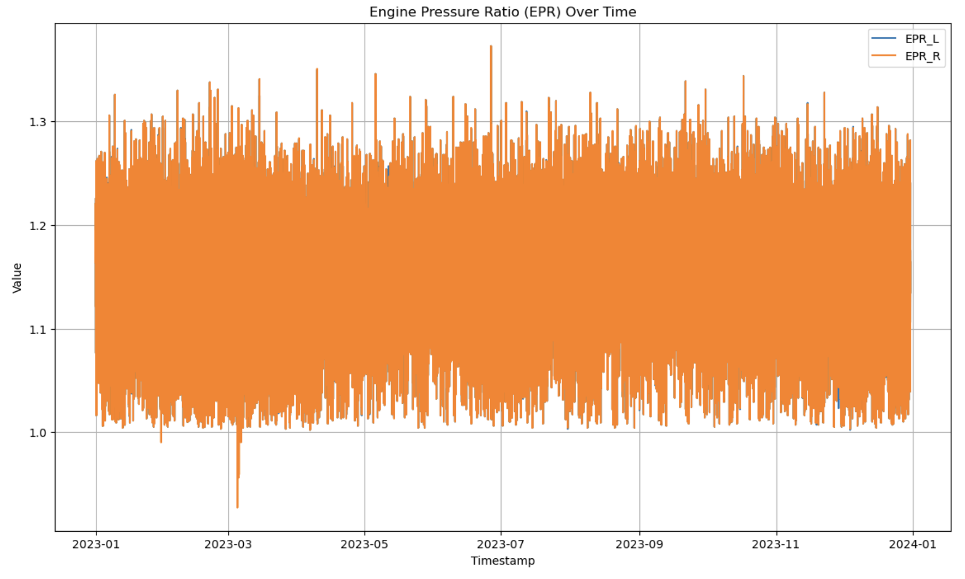
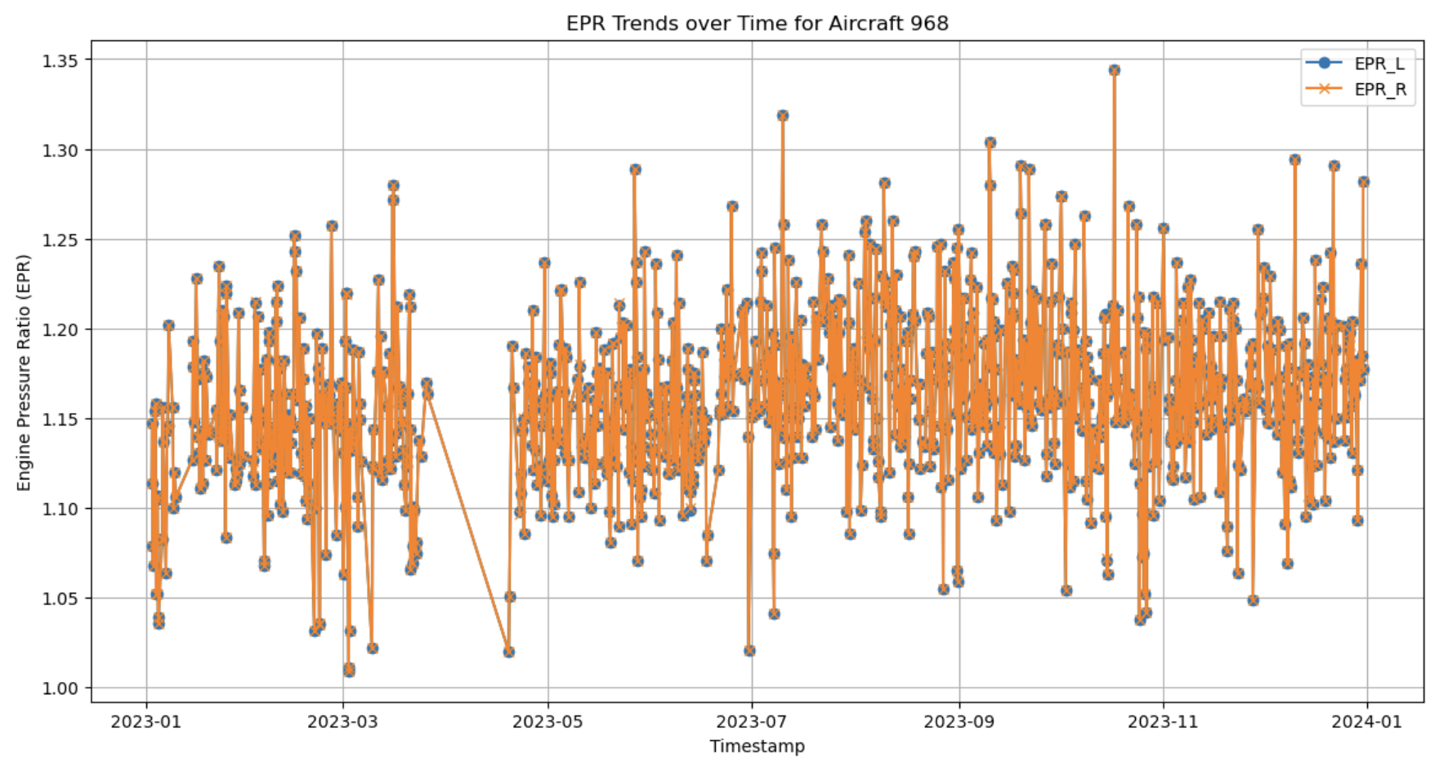
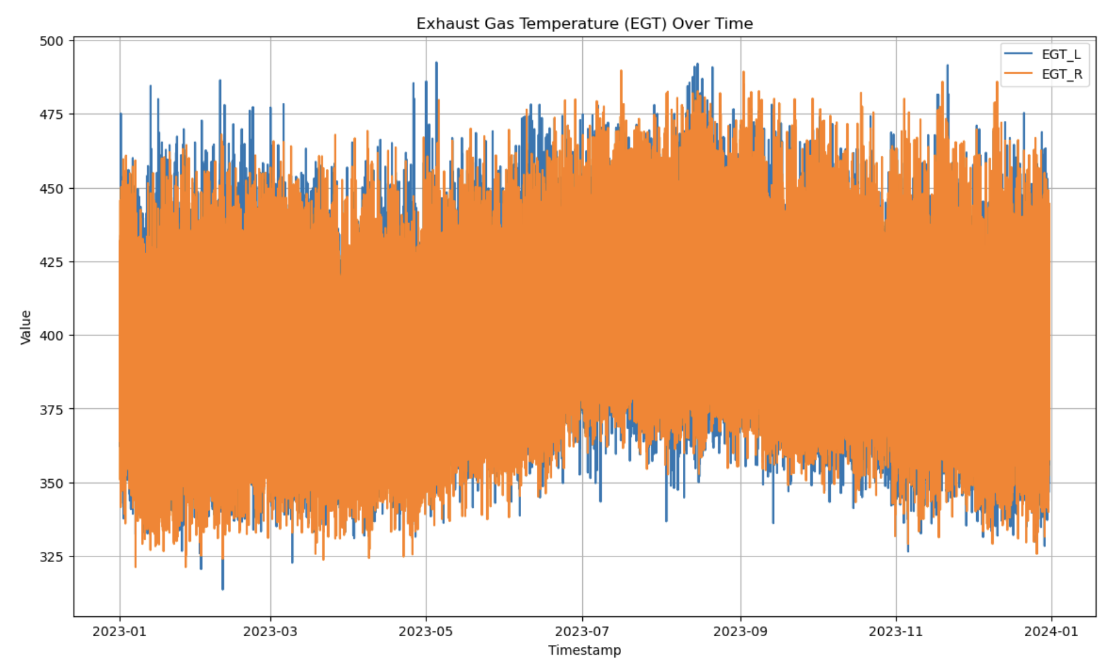
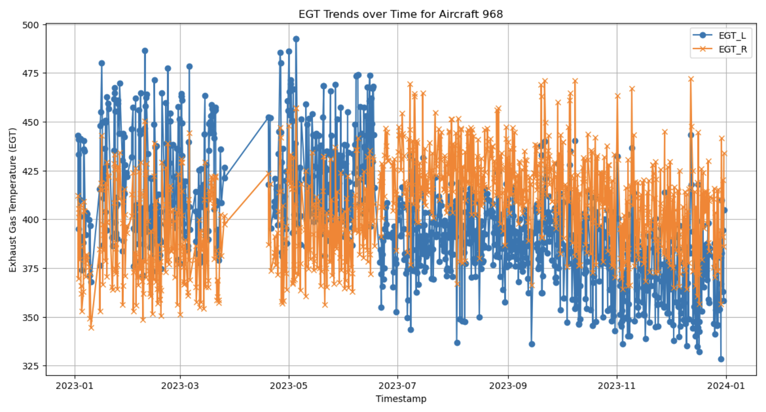
Left & Right Variable Time Series Plot
EPR
Group by Aircraft (ACID)
Compare left and right ratio over time
EGT

Slide 11
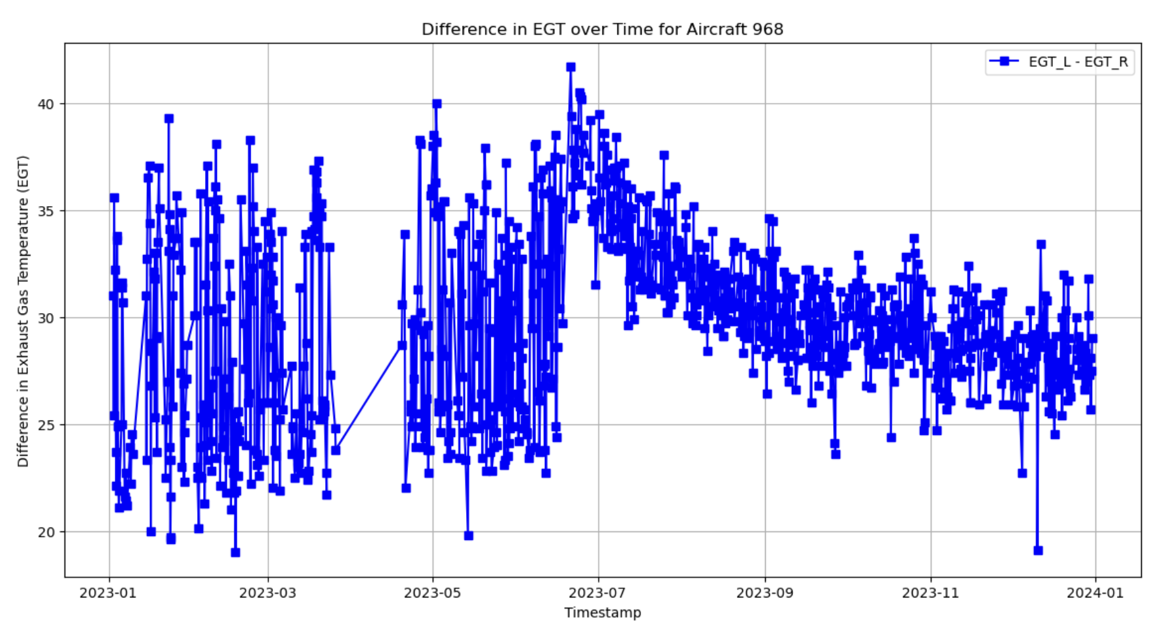
Huge Difference between left & right Exhaust Gas Temperature (EGT)
If difference is within the constant range, then it can also be called as normality
Seems to have seasonality, check it next step

Slide 12
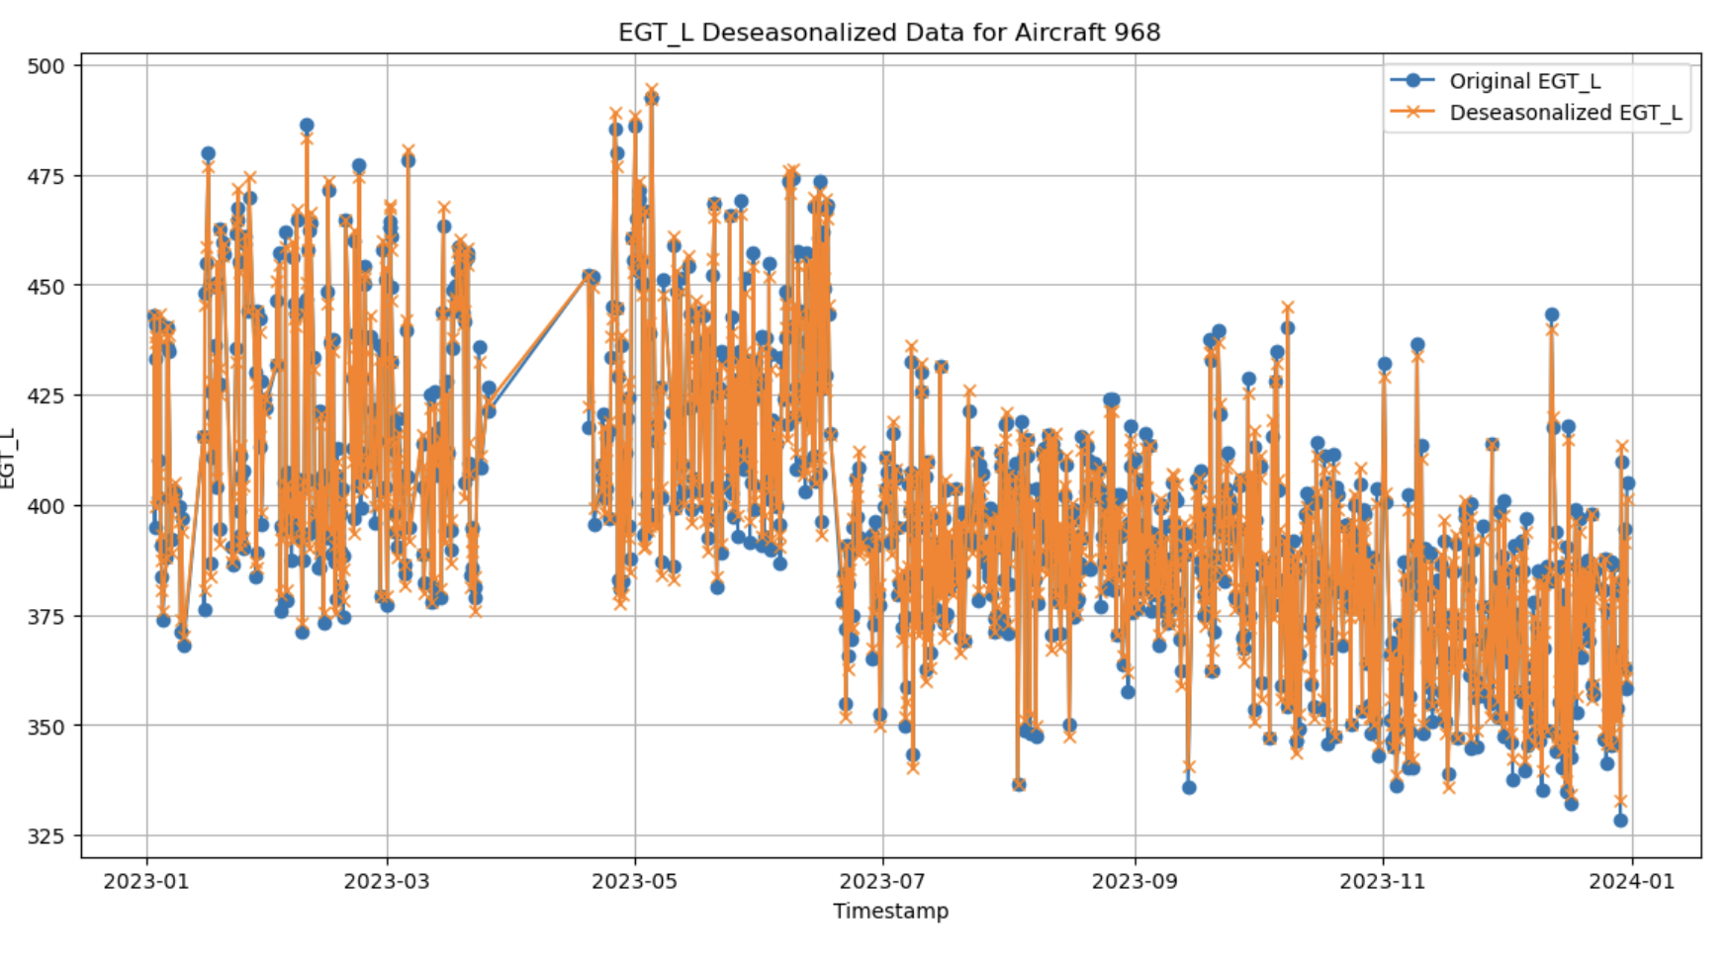
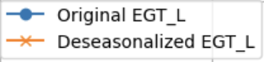
Seasonality Effect Check
Deseasonalized data closely resemble the original data
Does not exhibit a strong seasonality effect

Slide 13


03 Model

Slide 14

Data Partitioning
Train Data
80%
Val Data
20%
Test Data
Half Year
Half Year
Split data into half and half year
Data volume balance
Seasonality considerations
Avoid data leakage

Slide 15


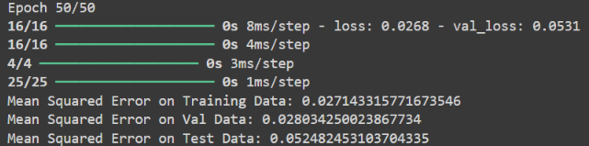
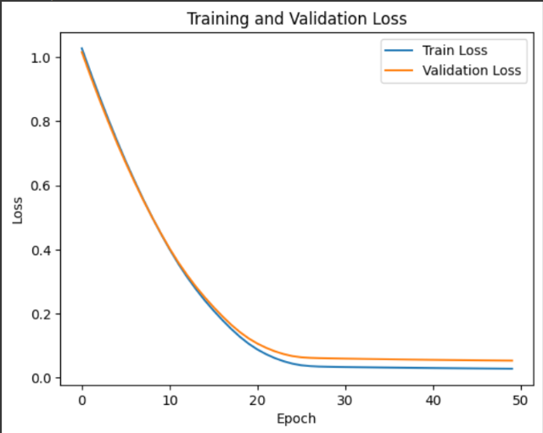
Autoencoder
Training data MSE: 0.027
Val data MSE: 0.028
Test data MSE: 0.05

Slide 16
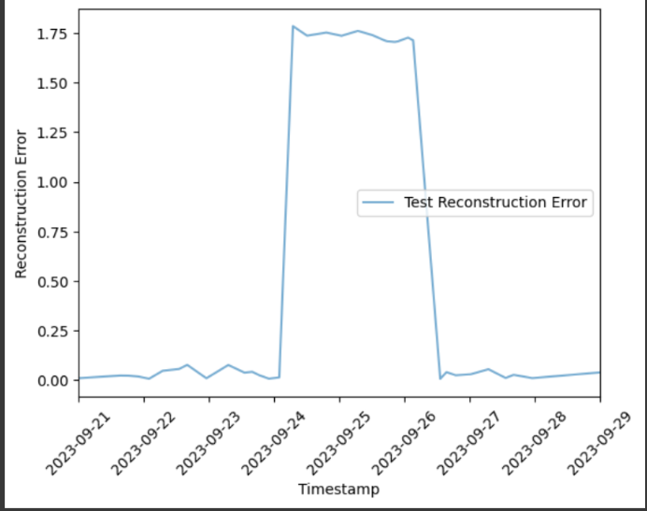
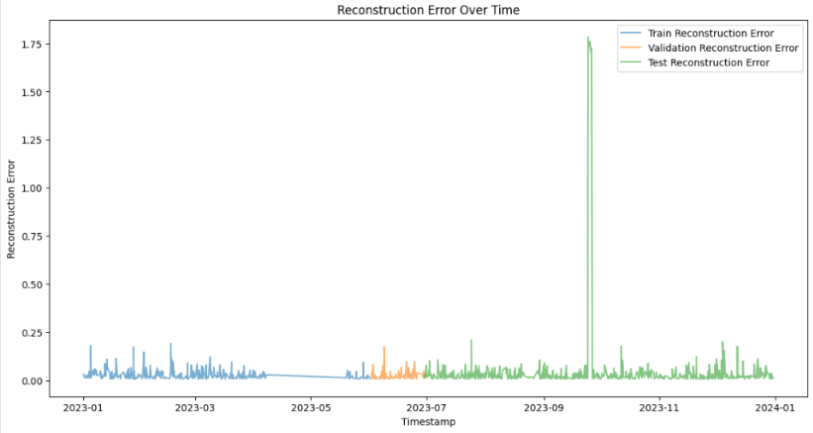
Reconstruction Error Over time for ACID 9679

Slide 17
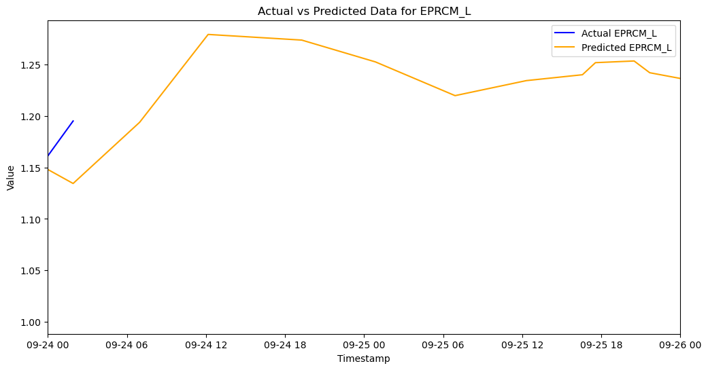
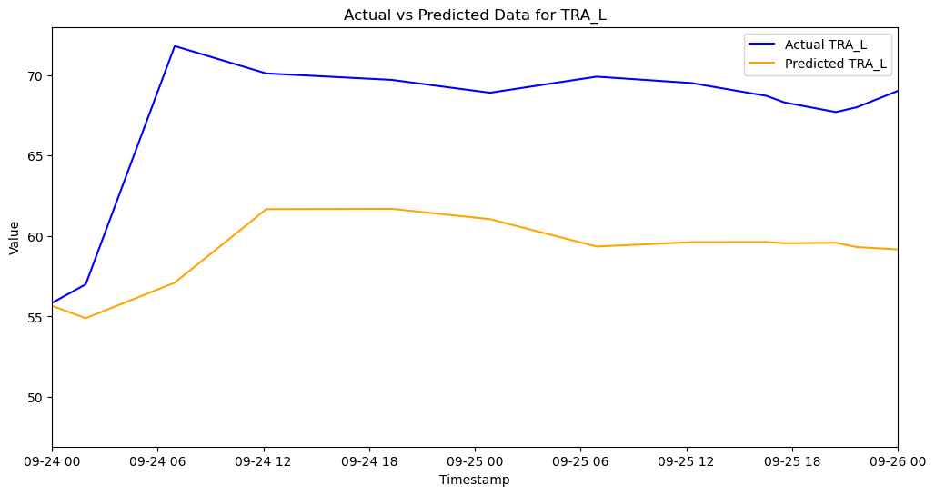
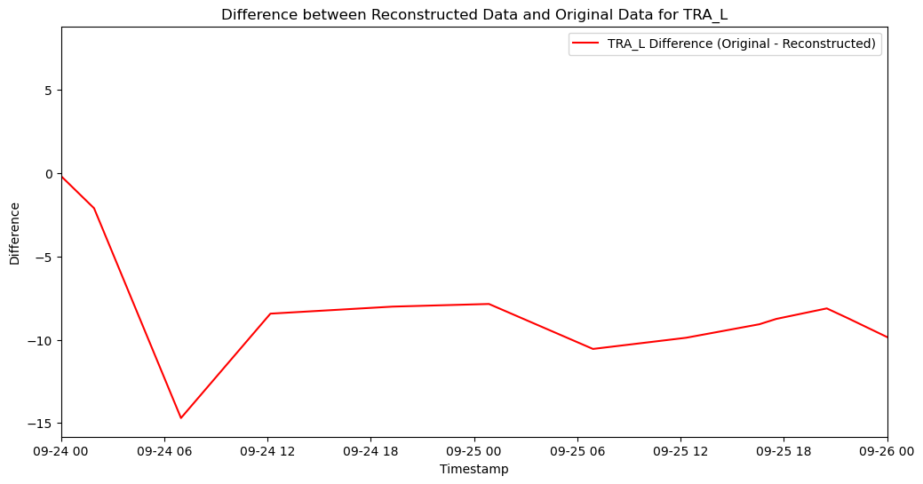
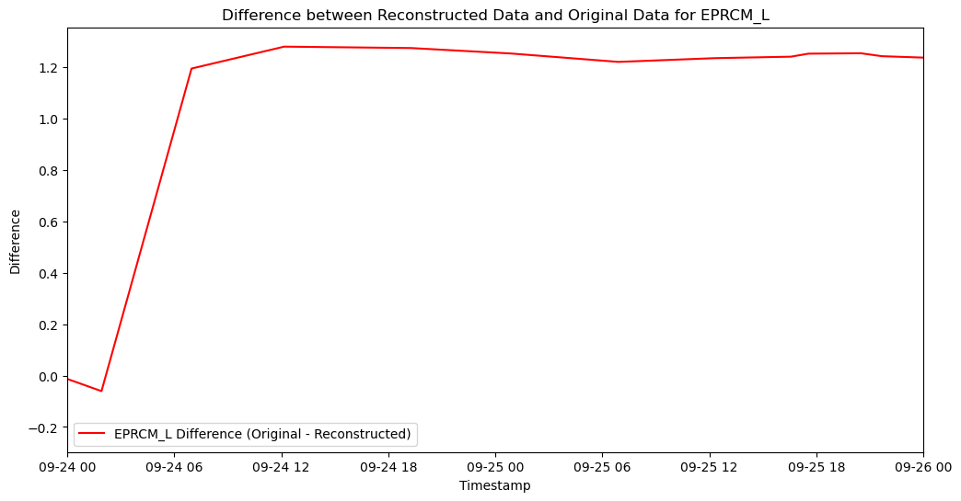
Deep Dive
EPRCM_L（Engine Pressure Ratio Corrected for Left） Engine）
TRA_L (Thrust Angle for Left Engine)
Predicted Data VS
Original Data
Difference plots

Slide 18
Conclusion
Effective Anomaly Detection
Model Generalization
Improved Data Quality
Future Enhancements
Notes:
We believe this model will effectively identify any abnormalities within a period for each aircraft dataset in the future
Enhanced Data Reliability: Our project successfully identified and addressed data gaps and anomalies in United Airlines' aircraft data, significantly improving data quality.
Autoencoder Model Implementation: The deployment of an autoencoder model provided a robust solution for detecting irregular patterns and potential issues in the data, contributing to better operational efficiency.
Risk Mitigation: By proactively identifying data inconsistencies, we’ve reduced the risk of errors in aircraft records, leading to safer and more reliable operations.

Slide 19

Thank You!

